Slide 1

Reach Milestone
HARSHA DUDDU & MANICHANDAN VALGOT

Slide 2
Description
Reach milestone game involves pure luck.
It is played between two players on a gameboard having numbered
gridded squares. A number of random “danger zones” are pictured on
the board, each connecting two specific board squares. The objective of
the game is to navigate from the start (bottom square) to the finish (top
square) with the help of die rolls and the resulted number helps or hinder
by crossing the Danger zones, of one’s game piece.

Slide 3
UML Diagram
User 1
The resulted number decides to move forward or reduced by few board positions
Every user gets a turn to Roll Dice
Milestone Reached
User 2

Slide 4
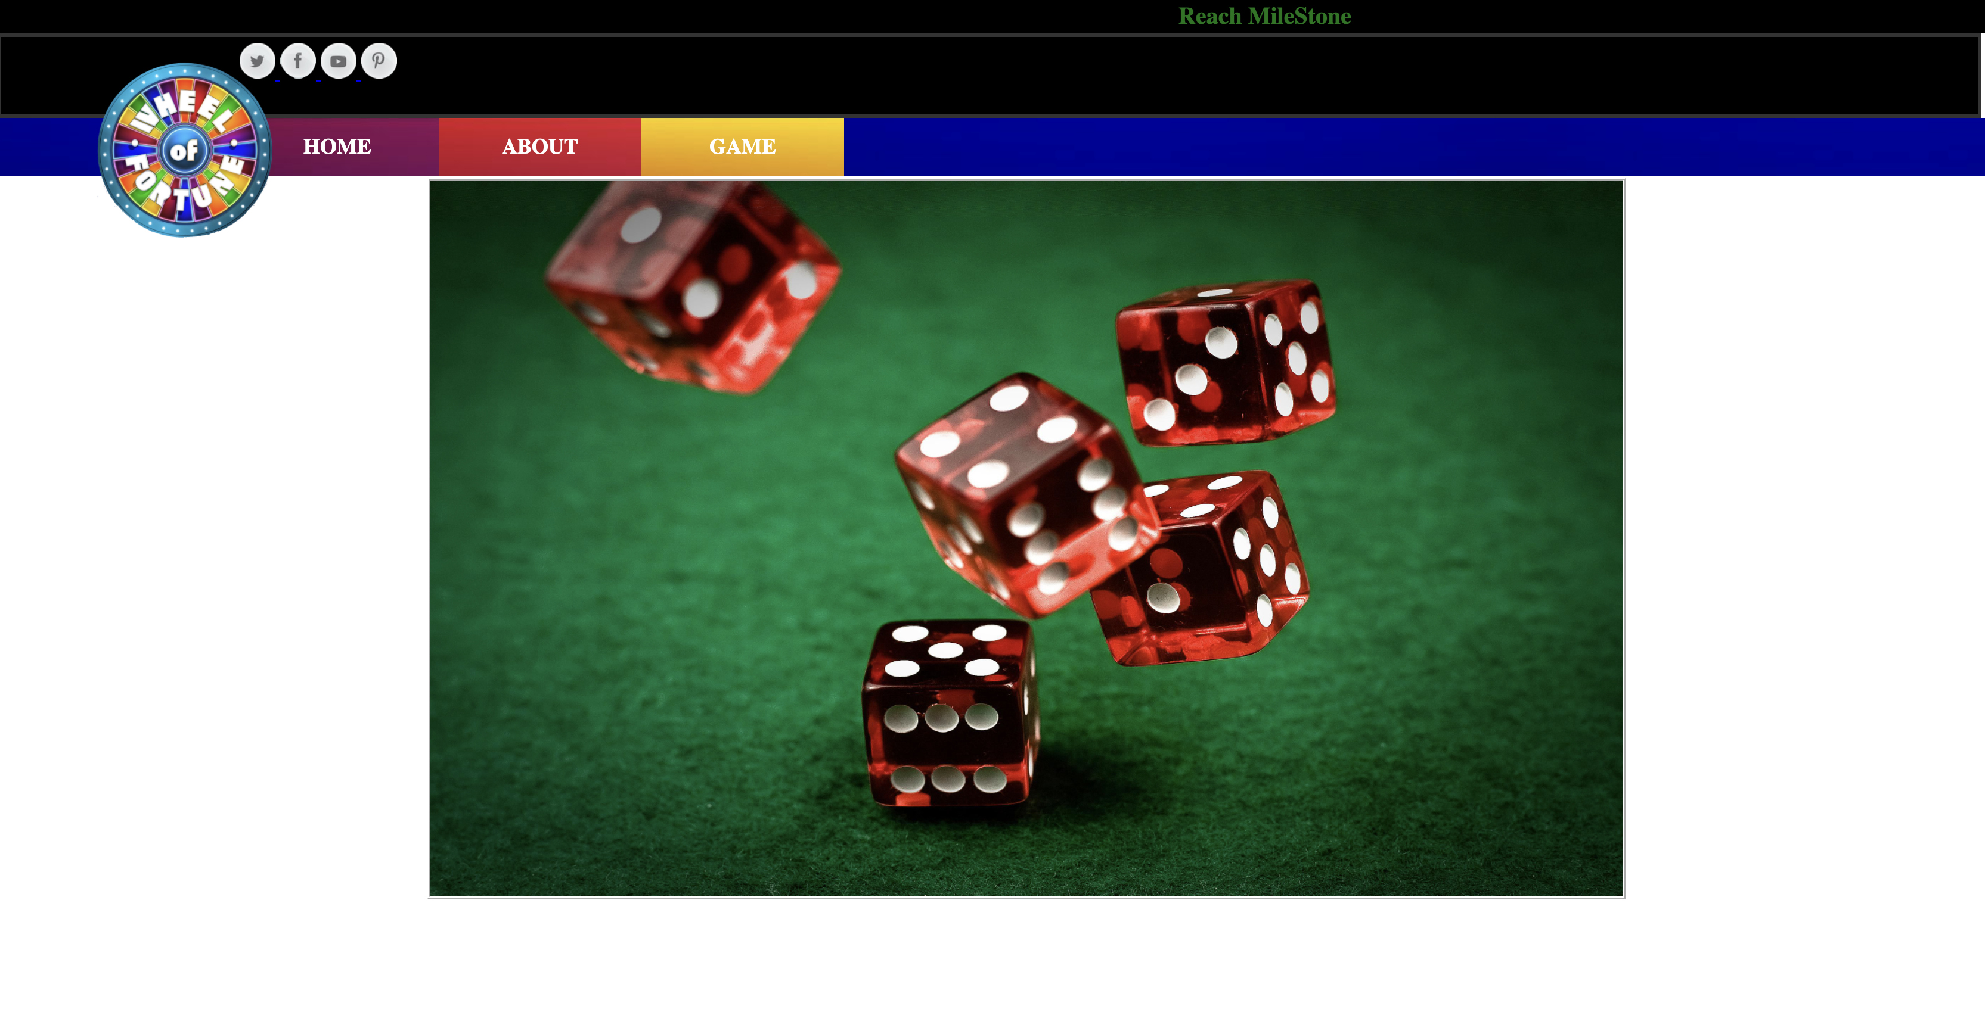
Home PAGE – UI

Slide 5
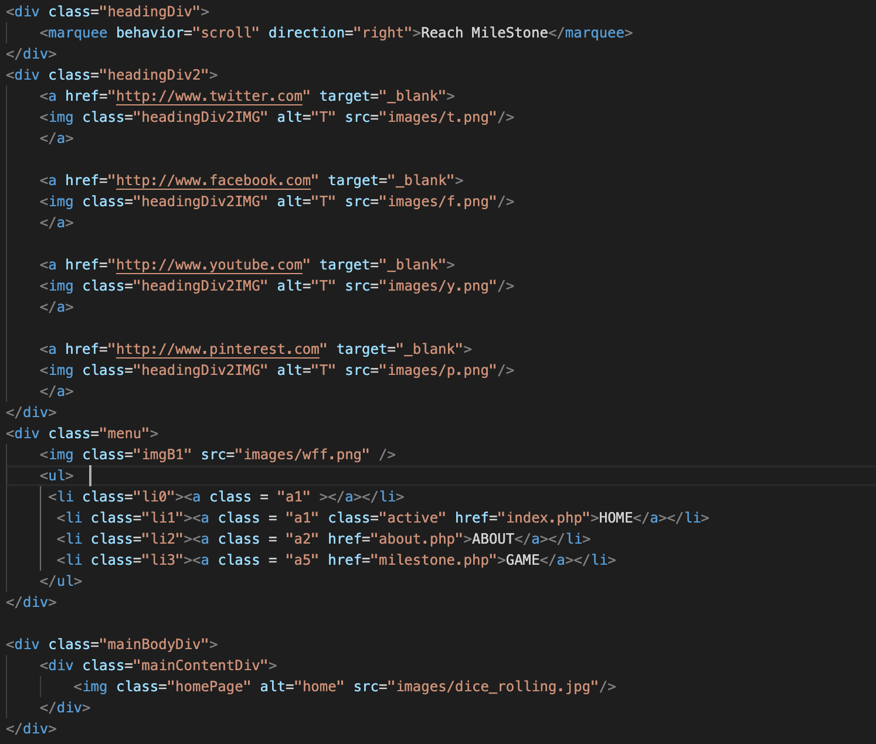
PHP code

Slide 6
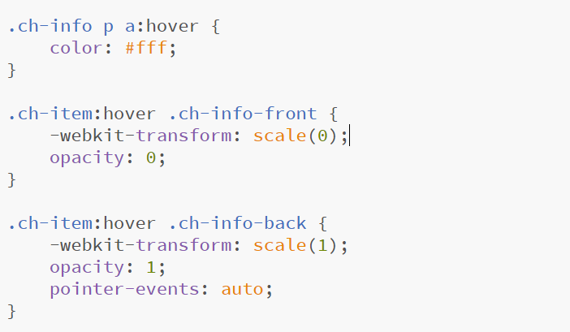
Image hover code

Slide 7
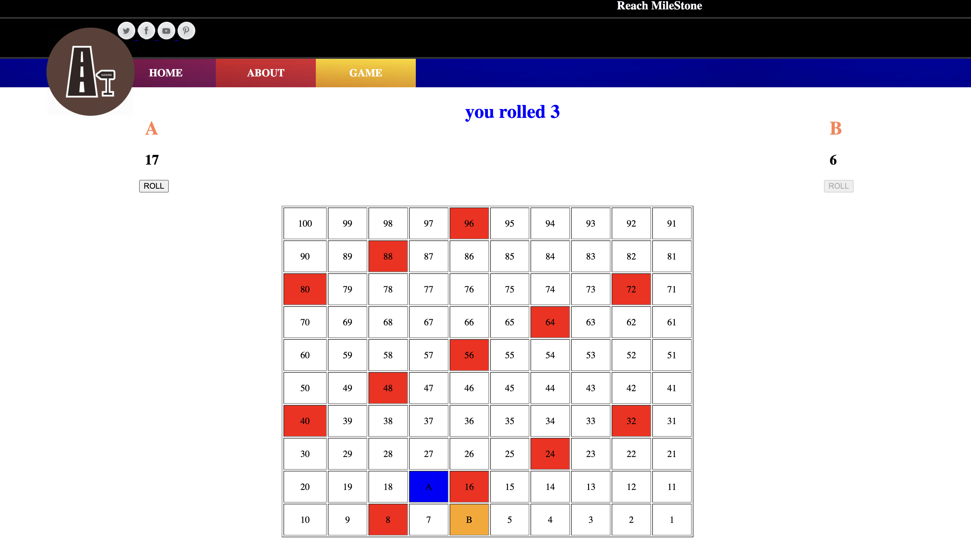
game - UI

Slide 8
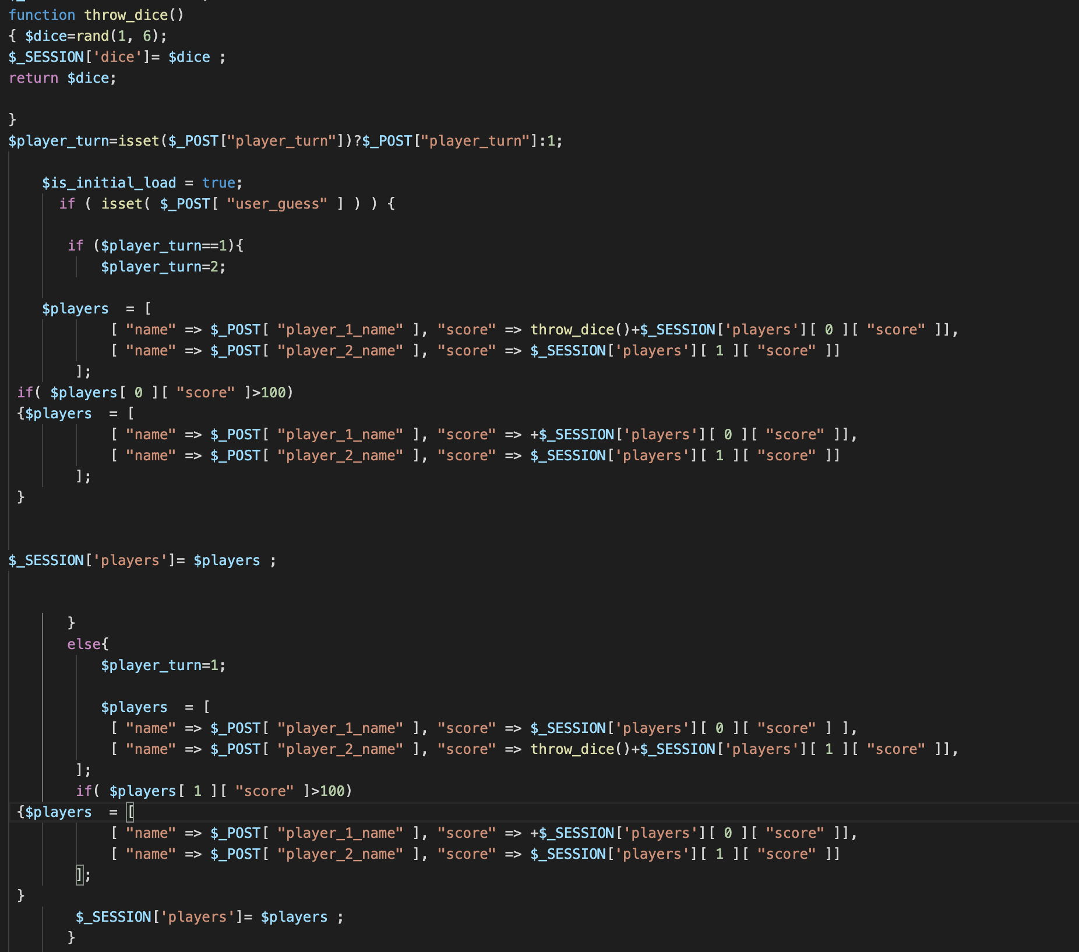
GAME VIEW – PHP

Slide 9
Testing
Php Sessions
CSS Validator
Safari
chrome
Mozilla

Slide 10


